Slide 1
“Here waits the bride? The effect of Ethiopia’s child marriage law”
By: Tamara McGavock
Group members: Mujahid Aleem, Nikolay Lesho, and Guneek Sahota
March 12th, 2021

Slide 2
Outline:
Introduction & Background - Guneek Sahota
Critique of original paper- Guneek Sahota
Motivation for our Research Paper- Guneek Sahota
Background of our Extension - Guneek Sahota
Extension Methodology - Mujahid Aleem
Methodology - Mujahid Aleem
Model- Mujahid Aleem
Extension & Findings- Mujahid Aleem
Model & Findings of our Model - Mujahid Aleem
Limitations & Critiques of our Analysis - Nick Lesho

Slide 3
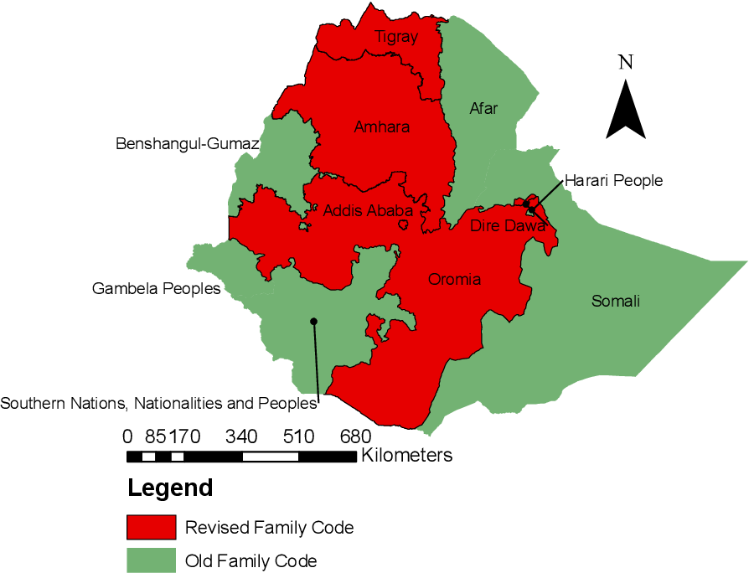
Introduction & Background
“Revised Family Code”(i.e., the child marriage law) by the Federal Democratic Republic of Ethiopia in July 2000
Raised the minimum age at marriage for ONLY girls from the age of 15 to 18 years old (with the exception of allowing marriages of girls at 16 or 17 with parental consent)
Regression used by author:
Age at first marriage_{i𝜔rt𝜏} = 𝛽 Post − Reform_{i𝜔rt} + 𝜂_{t} + 𝜇_{r} + 𝜇_{r} ∗ trend + v_{𝜏} + 𝜖_{i𝜔rt𝜏}
Main idea of the paper:
To estimate the effect of Ethiopia’s child marriage law by comparing average age of women married in years pre- and post-reform (i.e., years 1990-1999 and 2000-2009)

Slide 4
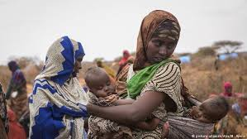
Critique of original paper
Exogenous timing of the reform being systematically related to pre-existing norms or trends in rates of early marriage
Potential in resulting in slightly altered survey data that author uses - likely to impact the event study analysis
Other policies and interventions conducted by the Ethiopian government resulting in decreased under-age marriages
NGO interventions
Ethiopia’s free primary education policy

Slide 5
Motivation for our research paper
To extend the original paper by utilizing more recent data (i.e., years 2016 and 2019) in order to analyze the long-term effect of the “Revised Family Code” reform
Main goal:
To observe any differences in results between the long-term effect of the reform on women’s age at marriage using 2016 and 2019 data and the time frame of 2000-2009 used by the author
Notes:
See if the long-term effect is consistent with the major impact that the reform had when it was just implemented - so the years just after the implementation of the policy which was sudden NOT gradual

Slide 6
Background of our extension
Using the 2016 survey dataset derived from Demographic and Health Surveys & the 2019 Mini Demographic and Health Survey - Ethiopia
Performing a similar regression to capture long-term effects of the marriage law
In particular, to conduct a difference-in-differences analysis not only before the law in 1990-1999, but also to make any observations of the changes between 2000-2016

Slide 7
Methodology of the Extension
Notes:
Alright!! I’ll be covering our extension’s methodology and findings, and how we accomplished our goal of extending the data.

Slide 8
Our Goals
Expand on more recent data
Original paper ended their study in 2009
How can we observe the long run effects of the marriage law passed in 2000?
Conduct a difference in difference study between 2000-2016 to study the effects of the reform
Notes:
The goal with our extension was to expand on more recent data. We did this - as Guneek mentioned, to learn of the long term impacts of the marriage law implemented in 2000. With the original paper ending its case study in 2009, we decided to expand by looking at the 2016 dataset. To outline the long term effects of the law, we conducted a difference and difference study to isolate the effects of the law between 2000-2016. The datasets we used contained the proportion of respondents per age group, and of course the age of first marriage (used exact ages in intervals - 15,18,20,22,25).

Slide 9
Our Model
Difference in difference model
Conducted using the 2000 and 2016 datasets
Respondents in 2000 are the control group
Respondents in 2016 are the treatment group
Setup of the model
Variables used in the model
Age of first marriage
“Reform” (dummy variable)
“Proportions of respondents” (respondent’s age at survey, continuous variable)
Ages of when people responded was also used to identify trends
15-19, 20-24, 25-29, 30-34, 35-39, 40-44, 45-49 were the age ranges
Notes:
In order to formulate a difference in difference model, we had to create several dummy variables to represent the changes before and after the reform. Recall we were looking at the most recent dataset - 2016, and the initial dataset released in 2000 before the reform was implemented. We will treat respondents in 2016 as the treatment group and respondents in 2000 as the control. This is suitable because the study conducted in 2000 contains information from a 10 year period before the reform (1900-1999), while the respondents in 2016 have felt the effects of the reform for 16 years.
First, we created the “Reform” variable, which is a dummy indicating whether the study was conducted before or after the reform. The dummy will activate for proportions made after 2000 (2016) - the treatment group, and will turn off for values in the control group (2000). Since the time of reform is the same as when the reform was implemented, it is sufficient to use this as the difference in difference estimator alone.
In addition, we will use the “proportion of respondents” to outline the changes in the distribution of how many respondents there are when a change in first marriage increases or decreases. This variable is used to outline the age of respondents at the time of surveying - and will be used to judge the changes in proportion in relation to age of first marriage. In addition to the difference in difference model, we created dummy variables for the age of each respondent to outline trends of how the age of respondents varies with the proportion of respondents of the particular age of first marriage.

Slide 10
How does the reform affect the age of first marriage?
How does the proportion of people in those age groups affect the age of first marriage?
Notes:
Hence, we are left with our model. The Beta variable to note will outline the effects of the law on the age of first marriage. Alpha represents the fixed effects and gamma represents the effects in the changes of proportion of respondents on the age of first marriage. For example if more responders are present when the age is lower or higher. We will use this model to answer two questions:
How does the reform affect the age of first marriage?
How does the proportion of people in those age groups affect the age of first marriage?

Slide 11
Extension & Findings
Notes:
Now let's go over what we found with our model.

Slide 12
What were some trends we observed?
Notes:
Firstly, what were some trends we observed overtime between 2000 and 2016?

Slide 13
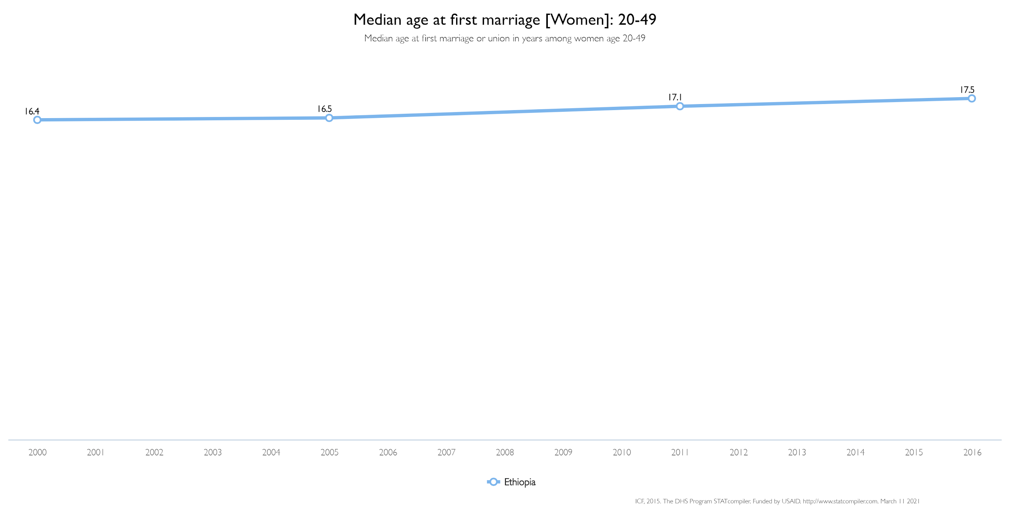
Upwards trend
Change in median age of first marriage is positive
1.1 difference from 2000-2016
Notes:
Here is our first graph, which outlines the median age of first marriage for women, who were 20-49 in the survey. As we can observe, there is an upward trend in the median age of first marriage from 16.4 to 17.5, a 1.1 increase in age from 2000 to 2016.

Slide 14
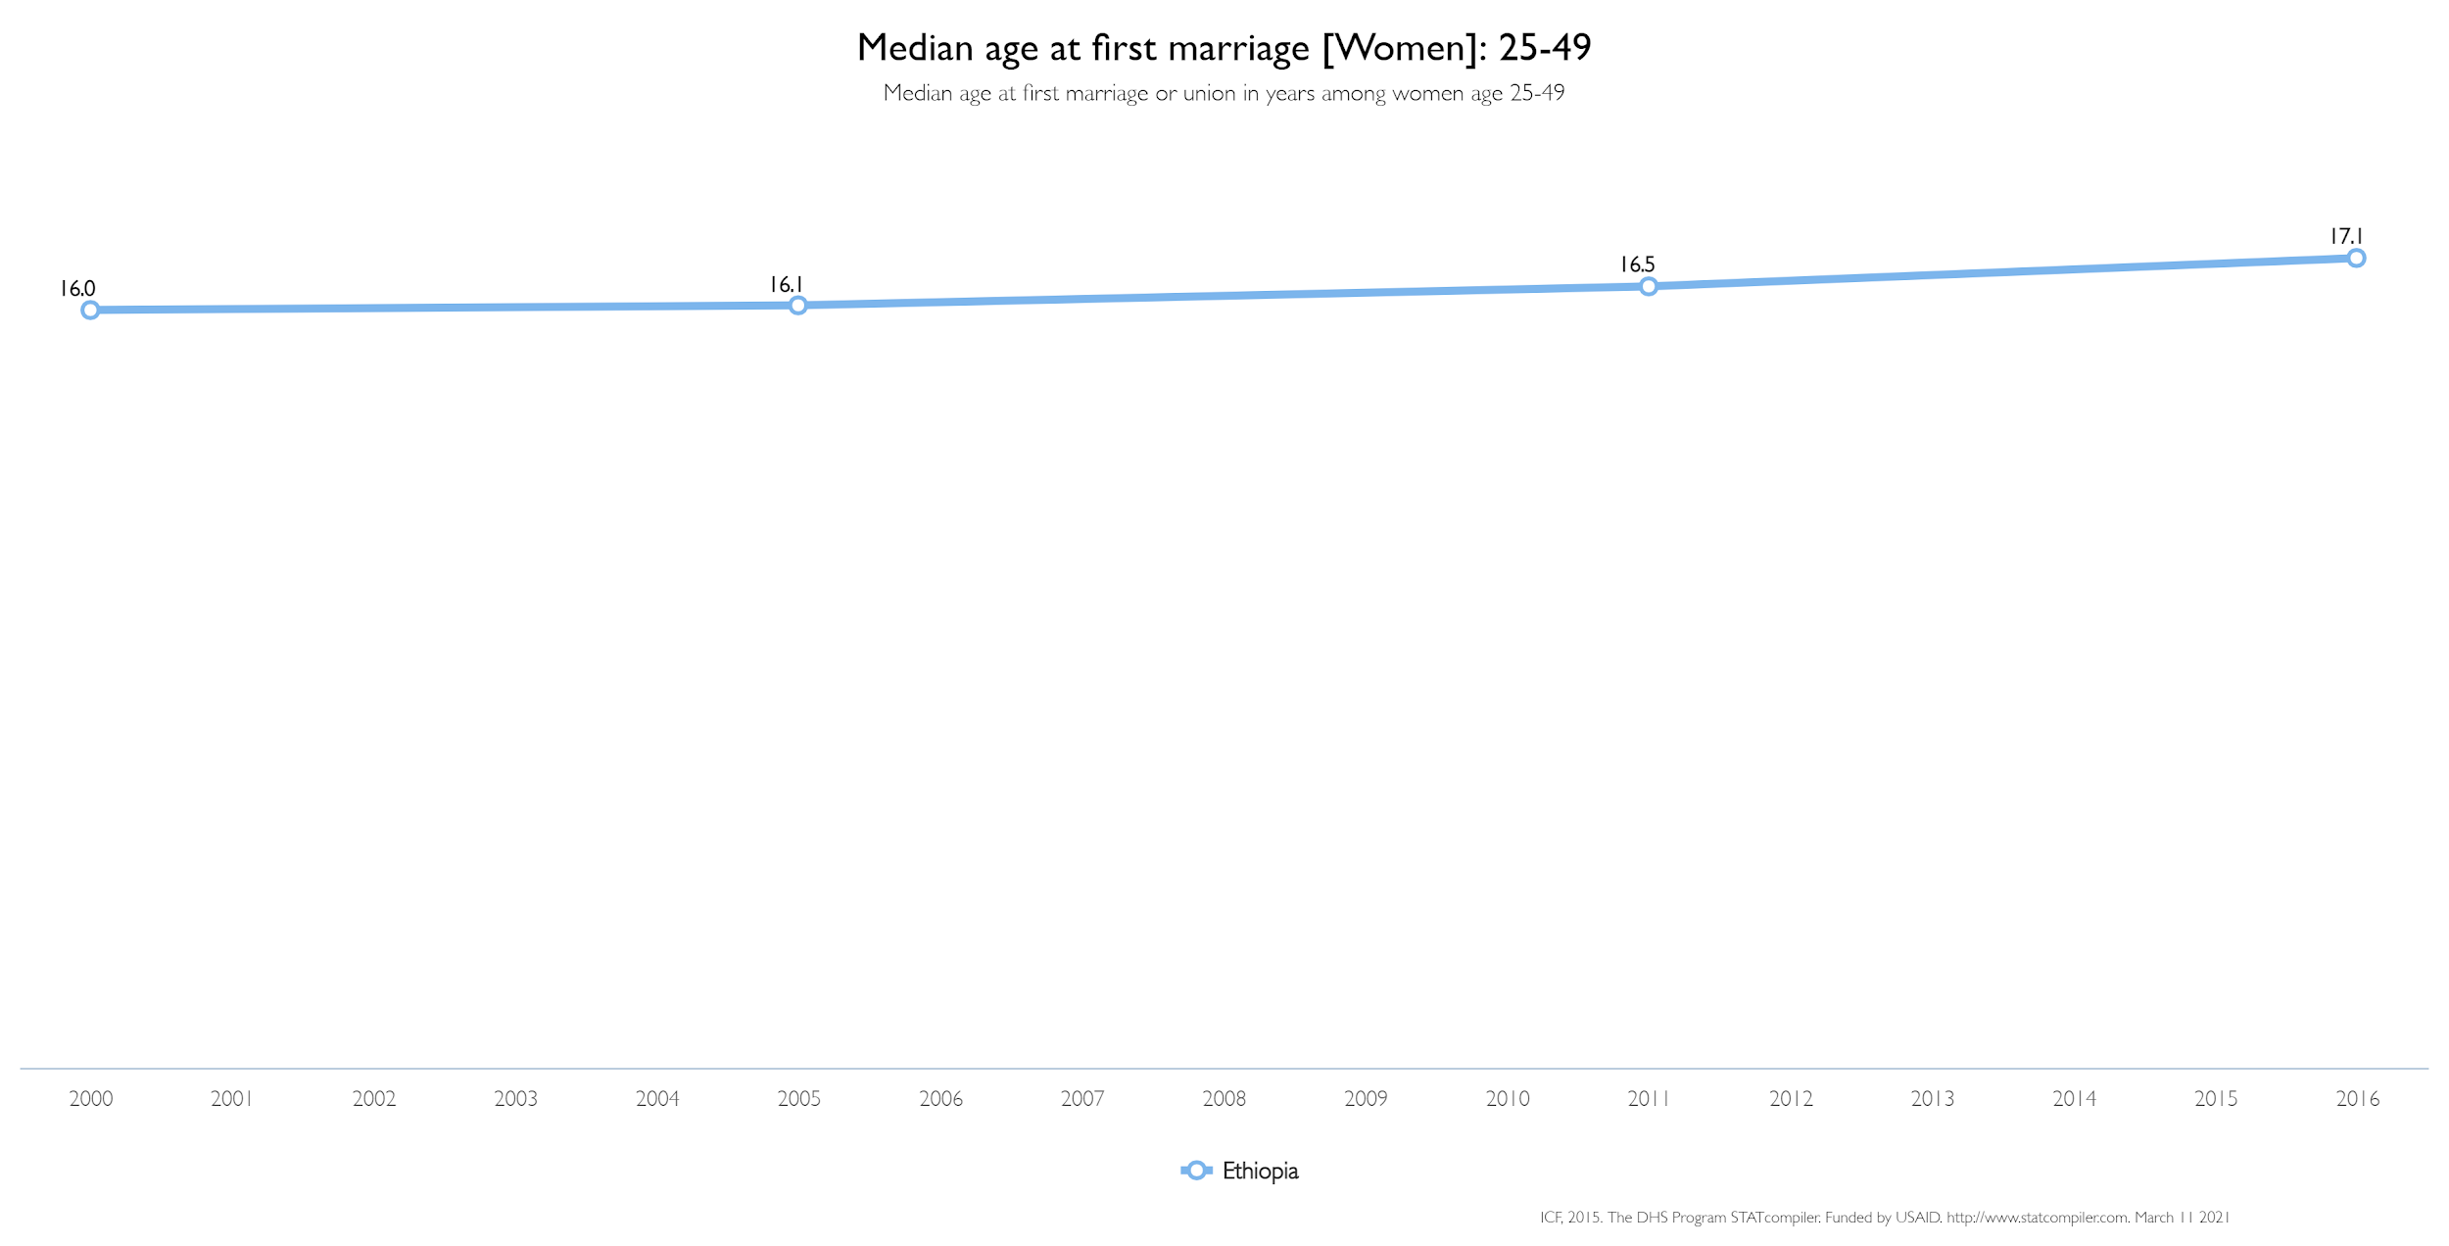
Upwards trend
Change in median age of first marriage is positive
1.1 difference from 2000-2016 (again)
Notes:
In our second graph, similar to the last one we now outline the median age of first marriage for women who were 25-49 in the survey. This is important as it highlights older individuals who may not have been married after the reform. Here we see another upward trend - indicating that the median age of first marriage is increasing. Specifically, 16 in 2000, to 17.1 in 2016, a 1.1 increase again.

Slide 15
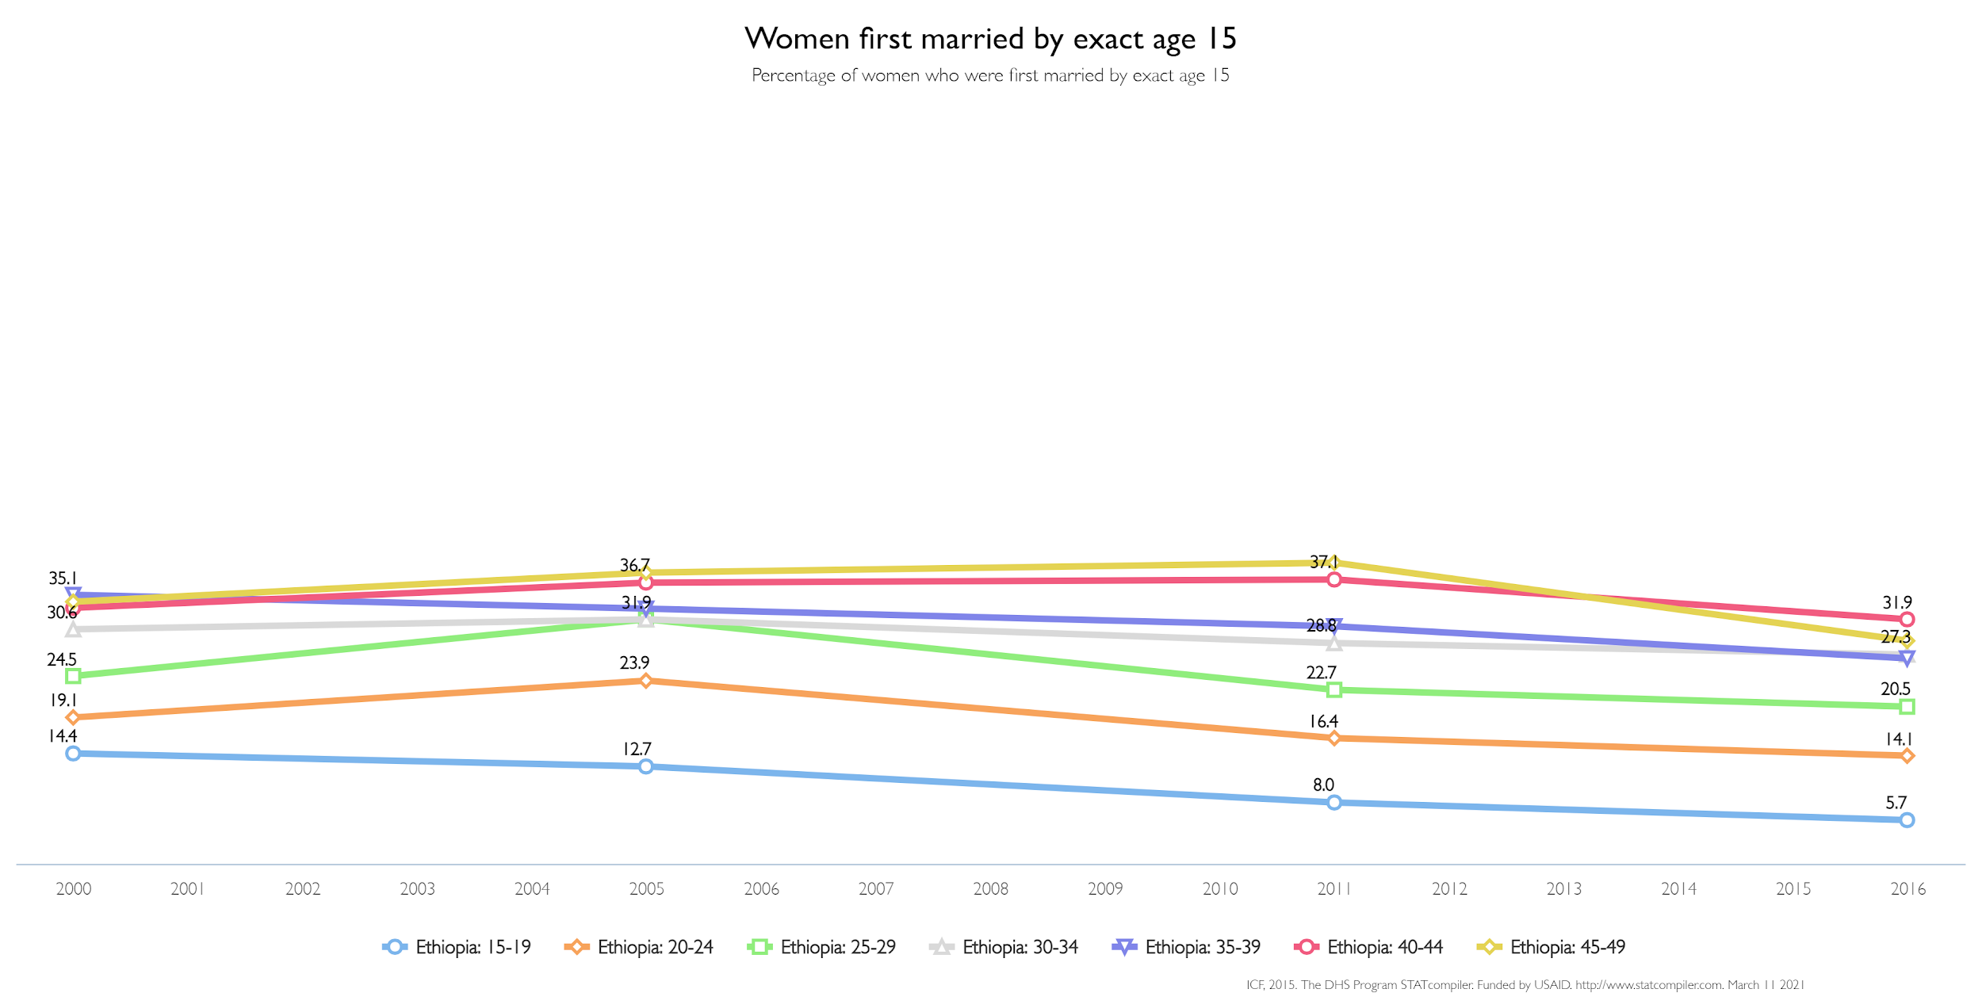
Proportion of those married is much higher in older generations
Downwards trend (slight bump in 2005 for older generations)
Sharp decline in younger generations overtime
Notes:
Now the next graphs - this and the next ones will outline the changes in the proportion of people who were married by an age labeled at the top. In this slide it outlines the proportion of respondents with their ages, of which got married by exactly 15. We can observe that the proportion of those married by 15 are much higher in the older generations, a 37.1 percentage peak of those aged 45-49 compared to 8 percent of those aged 15-19 in the same year (2011). There is a general downwards trend for all ages however, with all ages lowering the proportions they married by 15 by 2016 compared to those in 2000. The younger generations take a more drastic decline from 2000-2016, as likely the law is most impactful for them. Respondents aged 15-19 dropped from 14.4 percent to 5.7 percent from 2000-2016.

Slide 16
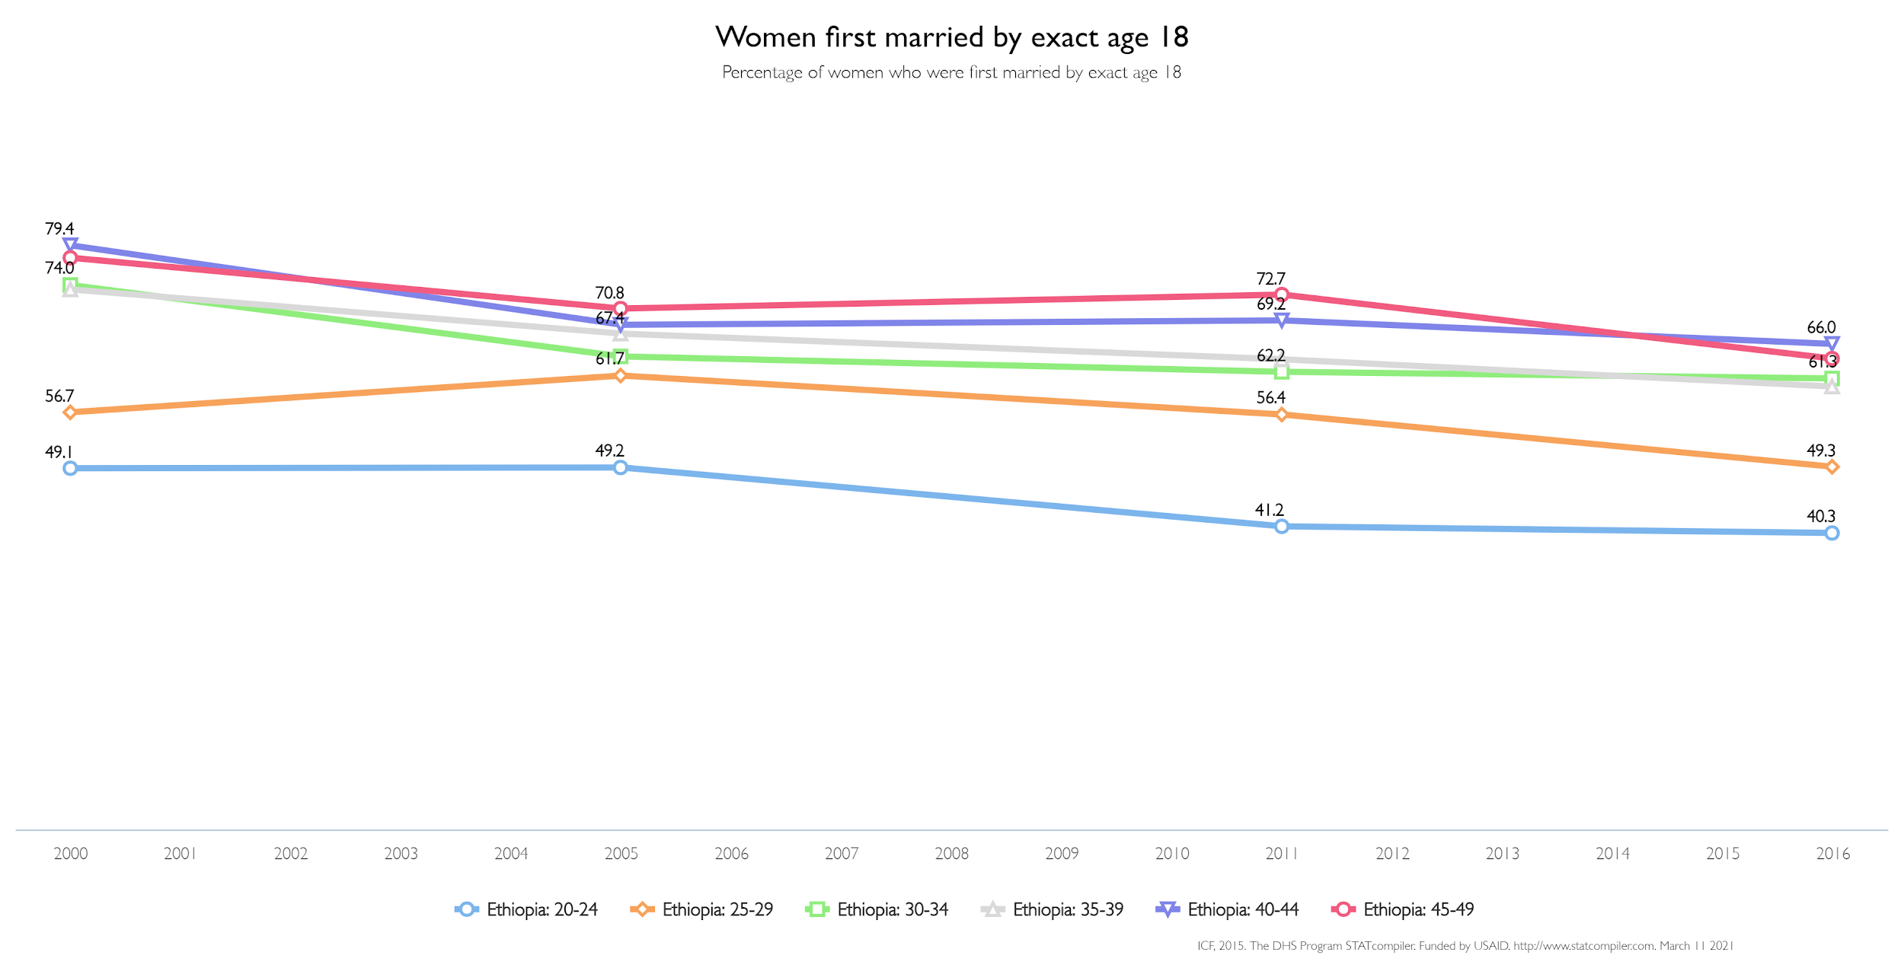
Proportions jump significantly
Is marriage more emphasized around this age?
Downward trend
Notes:
Next, this graph details respondents who were first married by the age of 18 with their respective ages at the time of survey. The most interesting observation is the sharp increase in proportion across all ages listed in the graph. For example, respondents aged 20-24 saw an increase from 14.4 to 40.3. This would indicate from ages 20-49 there is a greater emphasis on marriage at around 18. Yet still, we still see a drop in the proportion of those married by age 18 from 2000-2016.

Slide 17
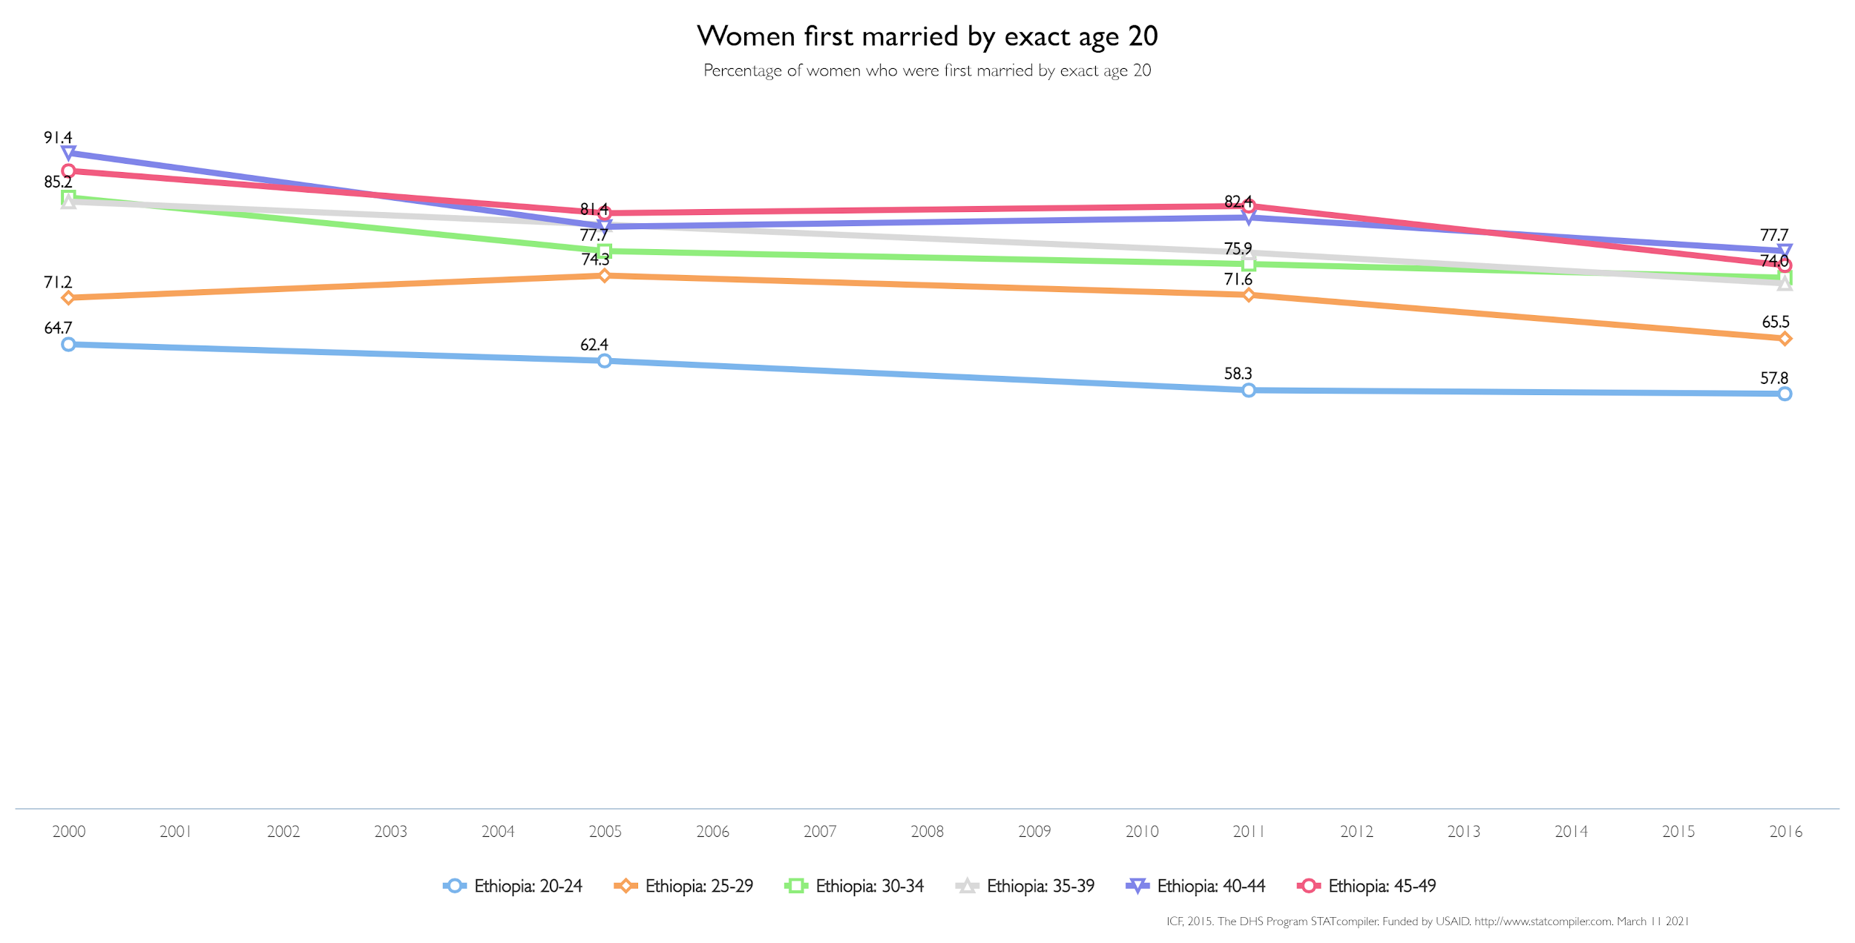
Downwards trend
Less fluctuations compared to previous age of first married graphs
Oldest generation sees sharpest decline
Notes:
This graph details respondents who were first married by the age of 20 with their respective ages at the time of survey. The proportion increases slightly for all ages, however not as significantly as the switch from age 18 to age 20. There is a slight downwards trend again, however less so compared to previous ages. The oldest generation sees the sharpest decline here, most likely indicating the respondents were married younger than 20 before they got married.

Slide 18
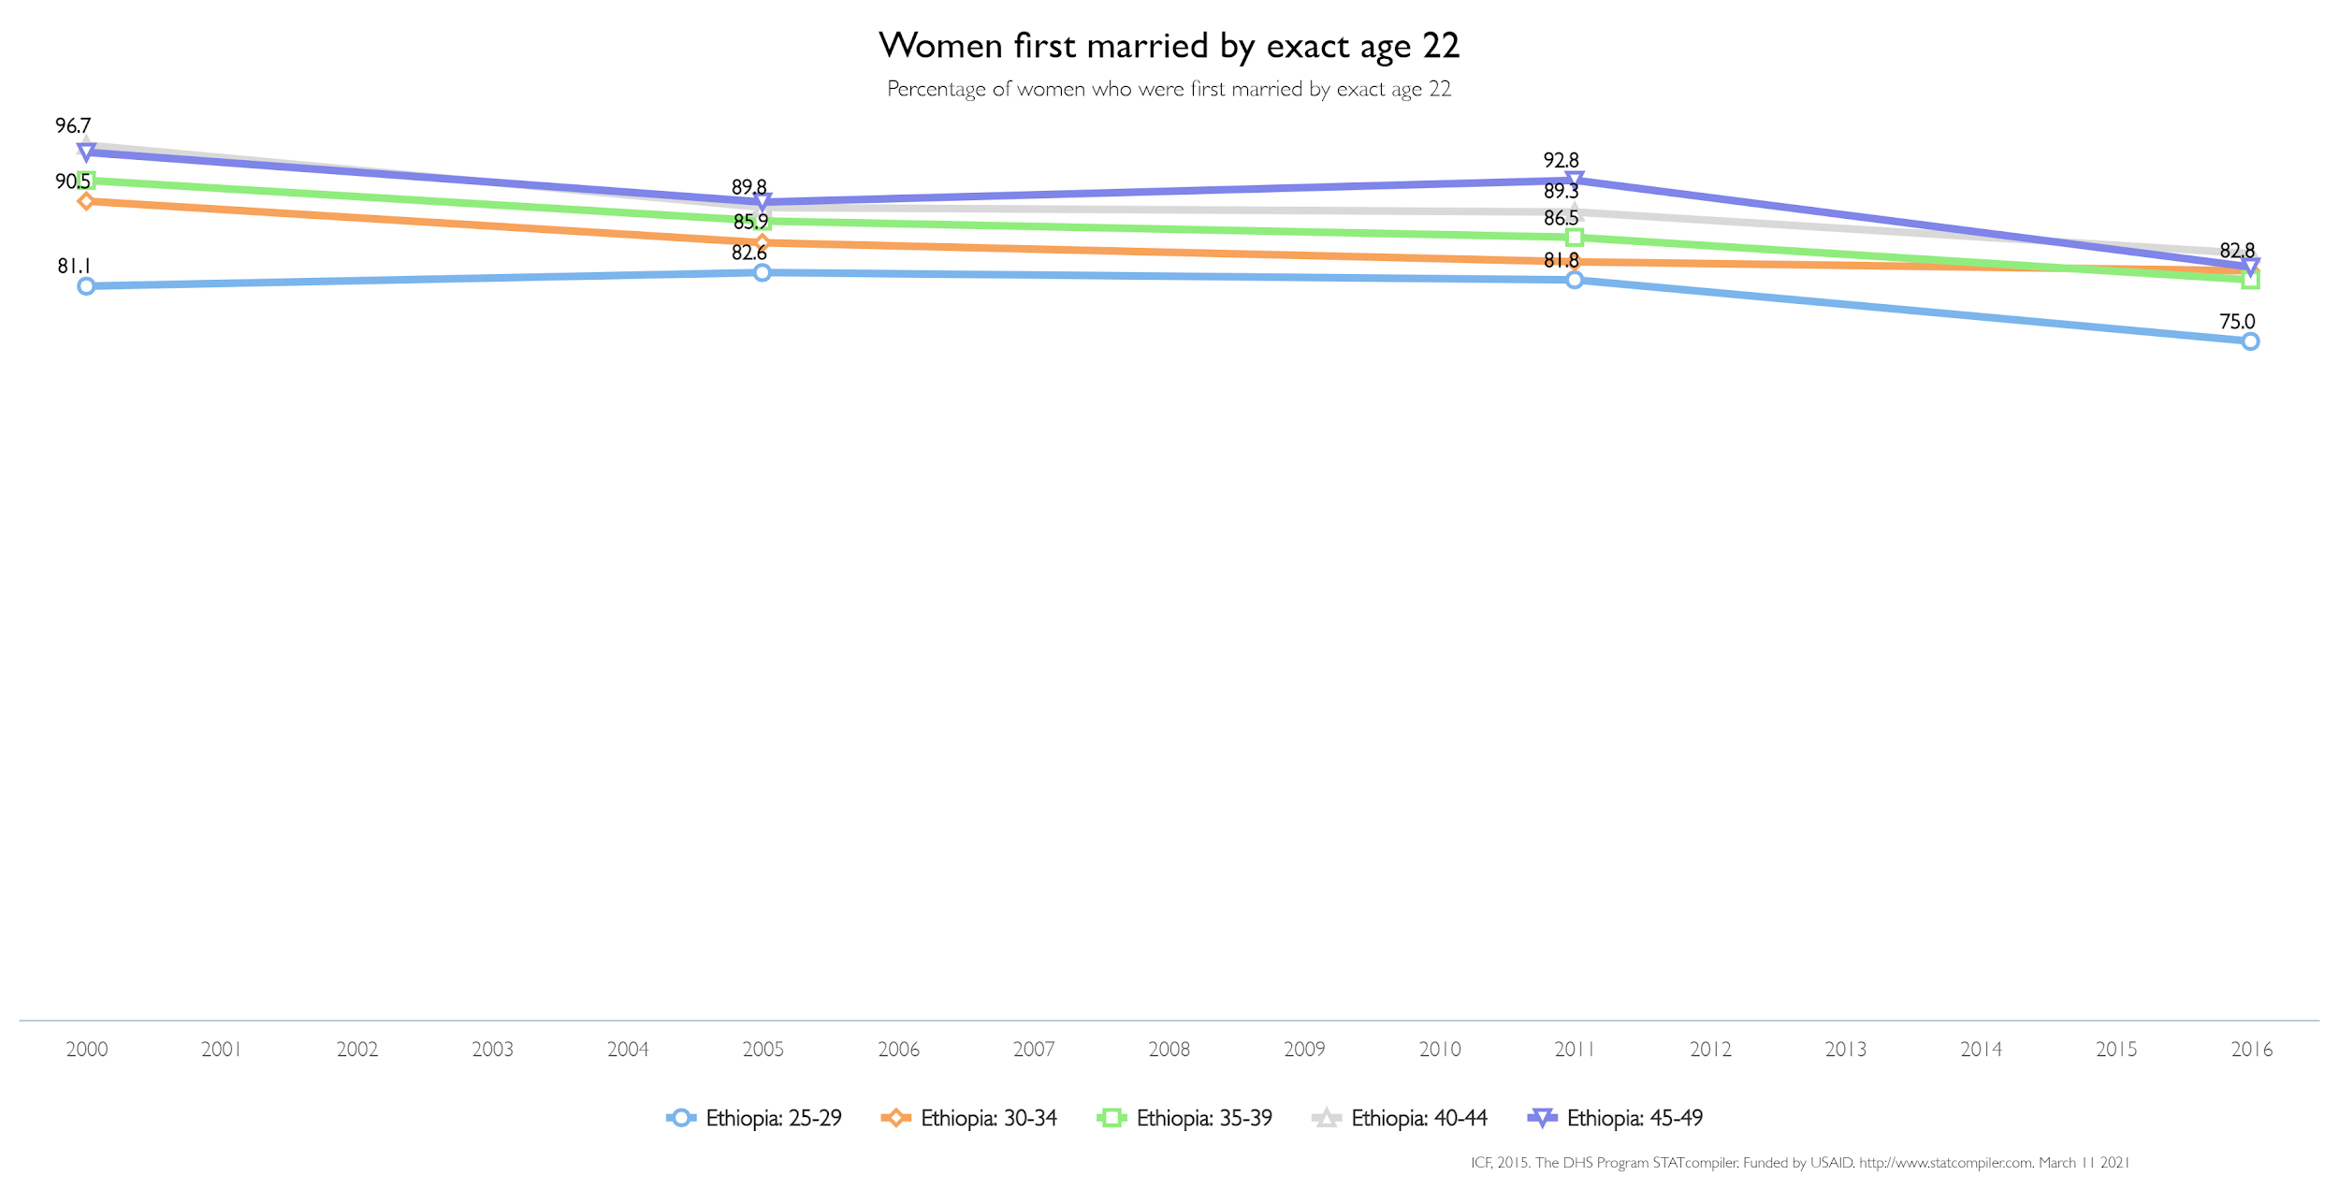
Majority of Ethiopians are married by age 22
Very slight downwards trend
Notes:
Now, this graph details respondents who were first married by the age of 22 with their respective ages at the time of survey. With the majority of proportions above 85 percent, we can observe that the majority of ethiopians get married by 22. There is a slight downwards trend again, however it is becoming clear that the effect of the law is becoming less prominent as age increases for the first marriage.

Slide 19
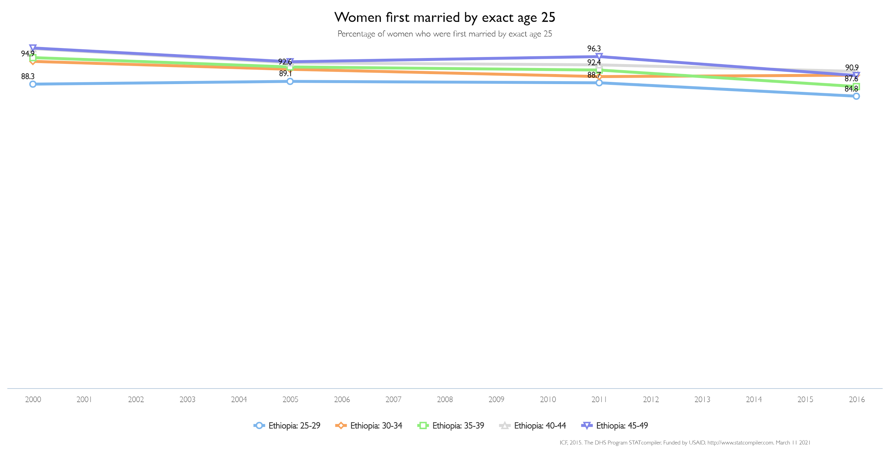
Slight increase in proportion
Downward trend is not as pronounced, but is still apparent
Older generations not as affected by the reform as very young generations
Notes:
Finally, this graph details respondents who were first married by the age of 25 with their respective ages at the time of survey. A very slight increase in proportion again, signifying most ethiopians are married before this point. The downward trend is even less pronounced and not as applicable to the age 30-34 group, but is slightly apparent otherwise through all generations especially from 2011-2016. Older generations seem to not be as affected by the reform as very young generations earlier.

Slide 20
Our Model
Notes:
Now we finally can observe what our regression accomplished.

Slide 21
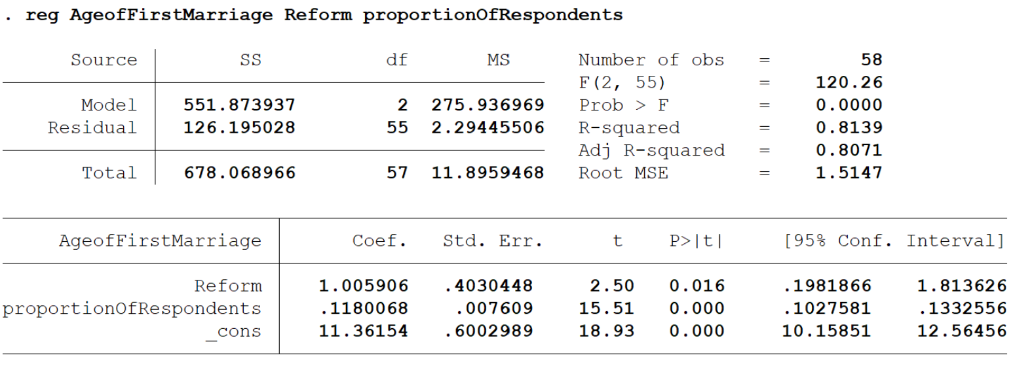
Notes:
Here is the stata output for our regression. Firstly, we can observe that the reform dummy variable coefficient - beta is positive. This indicates that the age of marriage increases by 1.005905 on average when the law is active. This is in line for what we saw with the trends lines before, with the downward trend from 2000-2016, especially for younger generations. We can also note that this value is statistically significant, indicated by the P>[t] section, where it is 0.016 (which is greater than 0). The proportion of respondents’ coefficient - gamma, is also positive - indicating that as the proportion of people increase, the age of marriage also increases, at .118. This is a small value, and indicates that the proportion of Ethiopians get married younger, which is also in line with our trend graphs (majority were married by 22). Nevertheless, this value is statistically insignificant.

Slide 22
Summary of Findings
Downward trend for when law was in effect, especially for younger ages
Statistically significant coefficient for reform variable, positive correlation
The reform did have an effect on age of first marriage, increased it
Proportion of respondents had a positive correlation - small increases in age of marriage, indicates the proportion is mostly concentrated at lower ages
Supported by trend graphs, older respondents were not affected much by the law and got married younger more often
Notes:
There was a downward trend for when law was in effect, especially for younger ages
Statistically significant coefficient for reform variable and a positive correlation. Therefore the reform did have an effect on age of first marriage it increased it
Proportion of respondents had a positive correlation - small increases in age of marriage, indicates the proportion is mostly concentrated at lower ages
This was supported by trend graphs, older respondents were not affected much by the law and got married younger more often

Slide 23
Limitations of our Analysis
In order to extend our analysis, we found new data on the DHS website for the years 2016 and 2019
However, the data was fully available only for 2016, while the 2019 survey data has not been published on the DHS website as its processing and analysis is still ongoing . Furthermore, while the fieldwork was conducted from January to June in 2016, it was only conducted from the months of March to June in 2019, adding further limitation to the availability of data from 2019.
In regard to our methodology, while the original regression incorporated various fixed effects and linear time trends, our much simpler regression only accounts for the changes in marriage age in response to the changes in the law, thus not accounting for other factors that may influence changes in the age of marriage over time, such as economic conditions

Slide 24
Critique
While the analysis examined the effect of the reform on the age of marriage in Ethiopia, a more in depth analysis could have examined the impact by different regions to account for inter-regional variations in economic factors
Overall, the regression demonstrates a statistically significant relationship between the reforms and long-term trends in the age of marriage in Ethiopia. However, the analysis could be extended even further to examine what impact the change in the age of marriage has on various economic factors, such as poverty and education.

Slide 25
References
Central statistics agency of Ethiopia. (n.d.). Retrieved March 7, 2021, from https://www.statsethiopia.gov.et/
McGavock, T. (2021). Here waits the bride? The effect of Ethiopia's child marriage law. Journal of Development Economics, 149, 102580. doi:10.1016/j.jdeveco.2020.102580
The DHS program. (n.d.). Retrieved March 8, 2021, from https://dhsprogram.com/data/available-datasets.cfm

